Slide 1
Digital Portfolio
STUDENT NAME: PRANATHI. P
REGISTER NO AND NMID: asunm1729212406034
DEPARTMENT: BACHELOR OF COMPUTER APPLICATION
COLLEGE: PRINCE SHRI BALAJI ARTS AND SCIENCE COLLEGE/
UNIVERSITY OF MADRAS

Slide 2
PROJECT TITLE
Storyfolio

Slide 3


AGENDA
Problem Statement
Project Overview
End Users
Tools and Technologies
Portfolio design and Layout
Features and Functionality
Results and Screenshots
Conclusion
Github Link
3/21/2024 Annual Review

Slide 4

PROBLEM STATEMENT
Traditional resumes = too plain 📄 Portfolios = too scattered 🔍 Need → A single, interactive, story-driven platform to showcase skills & journey ✨

Slide 5

PROJECT OVERVIEW
Storyfolio is not “just a portfolio” 🚀 It’s your personal digital storybook 📖 Blending creativity + professionalism to highlight who you are and what you’ve done.

Slide 6

WHO ARE THE END USERS?
👩‍🎓 Students → to showcase academic work 💼 Job Seekers → to stand out from CV stacks 🎨 Freelancers → to attract clients 🌍 Professionals → to build a digital identity

Slide 7

TOOLS AND TECHNIQUES
Cloudfolio is built using: ✅ HTML – For structure and content ✅ CSS – For styling and animations ✅ JavaScript – For interactivity and smooth navigation ✅ GitHub – For version control and sharing your code with others

Slide 8
POTFOLIO DESIGN AND LAYOUT
Minimal + Modern 🎨 About Me → Skills → Projects → Achievements → Contact 🔗 Timeline-based storytelling ⏳ Responsive & mobile-friendly 📱
8

Slide 9
FEATURES AND FUNCTIONALITY
✨ Smooth animations & transitions 🖼️ Interactive project showcase 📩 Contact form integration 🎯 User-friendly customization 🌐 Works across devices

Slide 10
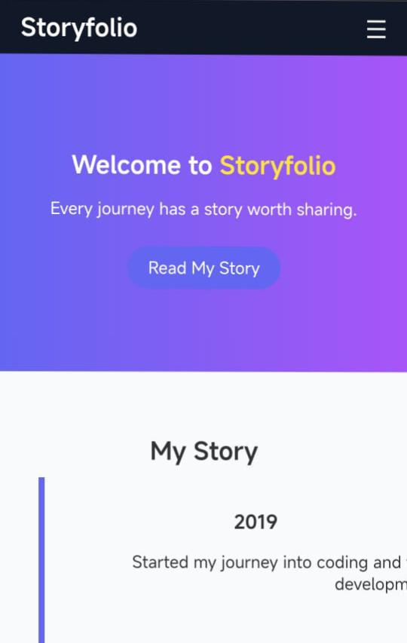

RESULTS AND SCREENSHOTS
3/21/2024 Annual Review
10

Slide 11
CONCLUSION
Storyfolio = Where resume meets storytelling 📝+📖 A creative platform that makes users shine, connect, and grow 🌟
11

